Slide 1

AgeWell Sunday Worship
Sunday 8 October 2017 – Pentecost 18

Slide 2
The Call to Worship
Opening Prayer
Greeting
The Lord be with you;
And also with you.
Welcome and Introduction

Slide 3
Hymn 154
Great is your faithfulness

Slide 4
Prayers of Adoration
Prayers of Confession
Lord, have mercy; Lord, have mercy.
Christ, have mercy; Christ, have mercy.
Lord, have mercy; Lord, have mercy.

Slide 5
The Declaration of Forgiveness
…And so I declare to you:
in Jesus Christ, we are forgiven people:
Thanks be to God!
Praise God, the source of life and birth; praise God the Word, who came to earth;
praise God the Spirit, holy flame;
all glory, honour, to God’s name.

Slide 6
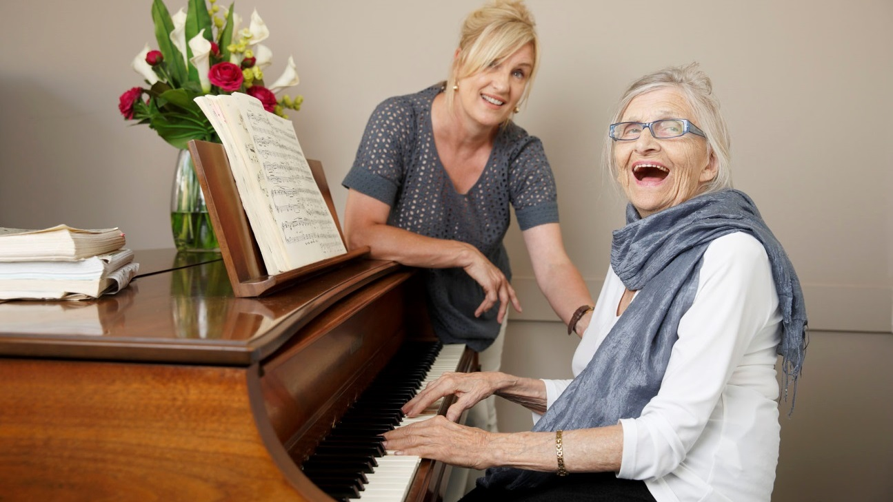
The Early Word
‘Honour your father and your mother.’

Slide 7
Hymn 430
Your words to me are life and health

Slide 8
Bible Readings
Mt 21:33-46
Other lectionary readings are
Ex 20:1-4, 7-9, 12-20;
Psalm 19;
Phil 3:4b-14.

Slide 9
Address or Sermon title here

Slide 10
Hymn 432
Christ is made the sure foundation

Slide 11
Offering
Offertory Prayer
We dedicate this money (and these gifts), Lord, for the work of your church, asking that you use all that we have and all that we are in your service. Amen.

Slide 12

We share our news, joys and concerns
We pray for the Church and the World.
Lord, in your mercy, hear our prayer.

Slide 13
The Lord’s Prayer
Our Father in heaven,
hallowed be your name,
your kingdom come,
your will be done on earth
as in heaven.
Give us today our daily bread.

Slide 14
Forgive us our sins as we forgive
those who sin against us.
Save us from the time of trial,
and deliver us from evil.
For the kingdom,
the power and the glory
are yours now and forever.
Amen.

Slide 15
Hymn 000
(select a suitable closing hymn)

Slide 16
Word of Mission
Blessing
Dismissal
Go in peace to love and serve the Lord: Thanks be to God!

Slide 17
Hymn 781
Father, bless us as we go.

Slide 18


Please join us for refreshments

