Slide 1
AgeWell Sunday Worship
Sunday 14 October 2018

Slide 2
The Call to Worship
Leader: Through our lives, we celebrate life.
Response: Let us praise God for the gift of life.
Opening Prayer
Greeting
The Lord be with you;
And also with you.
Welcome and Introduction

Slide 3
Hymn 154
Great is your faithfulness

Slide 4
Prayers of Adoration
Prayers of Thanksgiving
Prayers of Confession
1st Response
Forgive us when we close our ears to our older people.
2nd Response
Forgive us when we participate in the
unjust allocation of resources.
3rd Response
Forgive us when we fail to notice and act.

Slide 5
The Declaration of Forgiveness
…Hear then Christ’s words of grace to us. “Your sins are forgiven”
Thanks be to God!

Slide 6
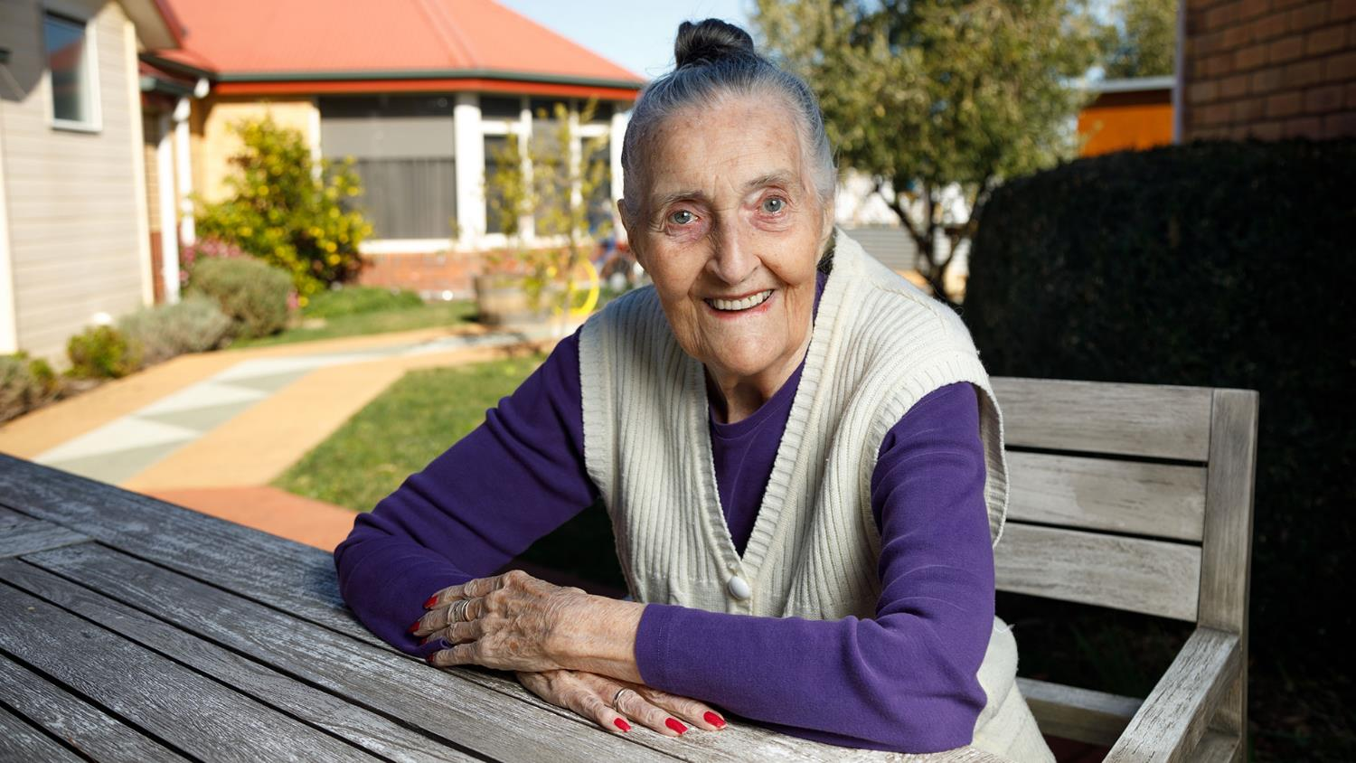
Creating our history of the last 100 years

Slide 7
Hymn 256
From heaven you came, helpless babe.

Slide 8
Bible Readings
1 Timothy 5:1-5
Mark 10:17-31
This is the Gospel of our Lord: Praise to you, Lord Jesus Christ!

Slide 9
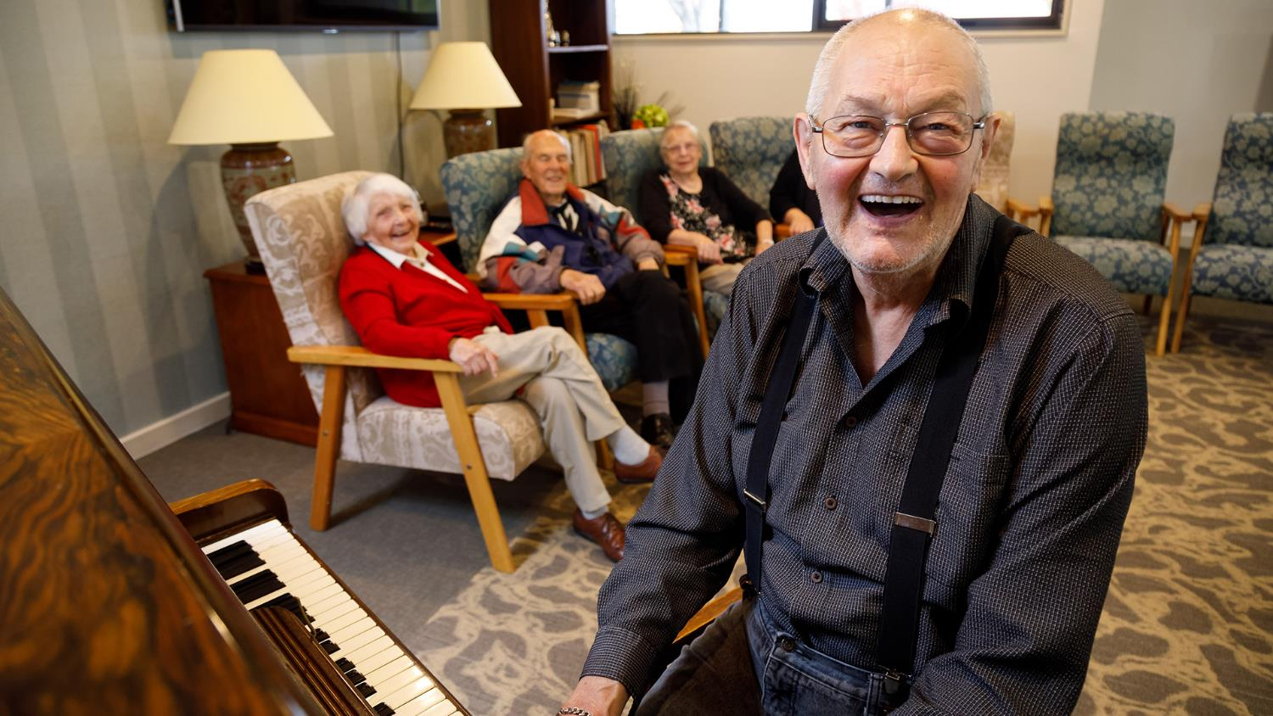
Uniting AgeWell – treating our older people like family.

Slide 10
Play video
YouTube: https://youtu.be/hY6s7goZdWw
Download: https://www.dropbox.com/s/c4ycy08p1e5ew21/Age%20Well%20Sunday%20Download.mp4?dl=0

Slide 11
Hymn 209
And can it be that I should gain

Slide 12
Offering
Offertory Prayer
We dedicate this money (and these gifts), Lord, for the work of your church, asking that you use all that we have and all that we are in your service. Amen.

Slide 13
We share our news, joys and concerns
Prayers of the People
Leader: Lord of all ages
Response: Hear our prayer.

Slide 14
The Lord’s Prayer
Our Father in heaven,
hallowed be your name,
your kingdom come,
your will be done on earth
as in heaven.
Give us today our daily bread.

Slide 15
Forgive us our sins as we forgive
those who sin against us.
Save us from the time of trial,
and deliver us from evil.
For the kingdom,
the power and the glory
are yours now and forever.
Amen.

Slide 16
Hymn 315
Mine eyes have seen the glory of the coming of the Lord

Slide 17
Word of Mission
Blessing
Dismissal
Go in peace to love and serve the Lord In the name of Christ. Amen

Slide 18
Hymn 781
Father, bless us as we go.

Slide 19
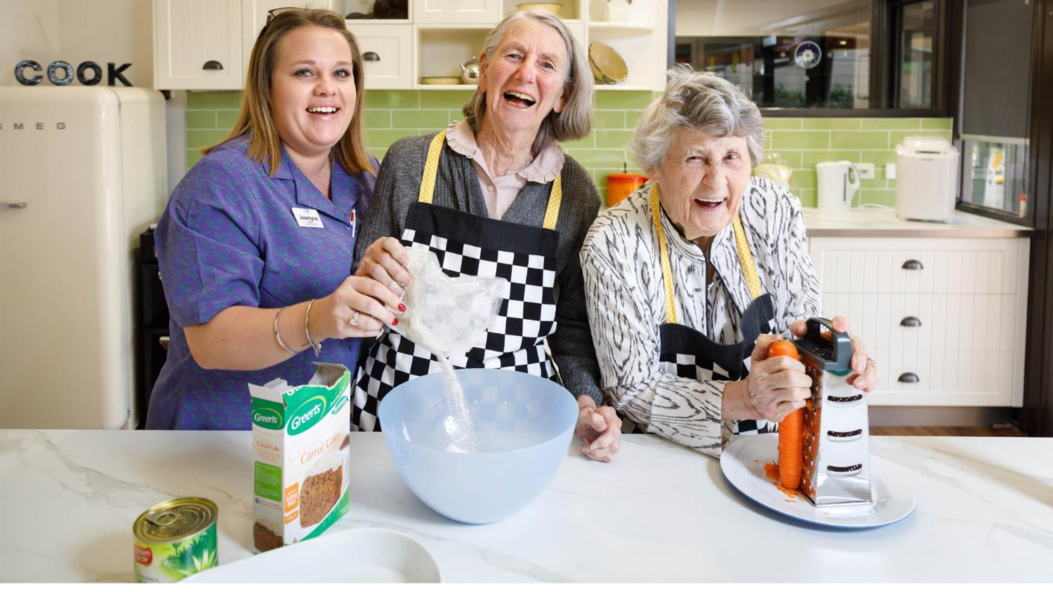
Please join us for refreshments

